Slide 1
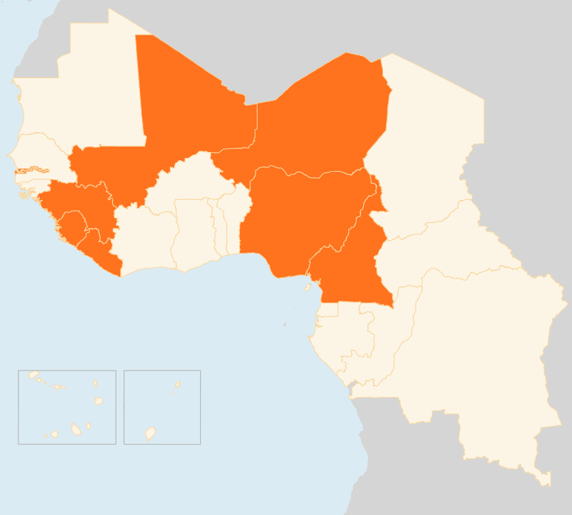

REGION DE L’AFRIQUE DE L’OUEST ET DU CENTRE
Aperçu humanitaire hebdomadaire de OCHA - Bureau Régional pour l'Afrique de l‘Ouest et du Centre
3 – 9 Mar 2015
CAMEROON
117,000 INTERNALLY DISPLACED DUE TO NIGERIA SPILL-OVER
The number of people internally displaced in northern Cameroon, fleeing cross-border attacks from Nigeria or preventively leaving their homes, is now estimated at more than 117,000. Cameroon also hosts some 66,000 Nigerian refugees. Humanitarian actors continue to scale up their capacities to respond to the urgent needs of refugees, IDPs and local communities.
NIGER
JOINT OFFENSIVE WITH CHAD
On 8 March, Chad and Niger launched a joint military operation against Boko Haram in Nigeria, which marks Niger’s first major intervention in Nigerian territory to combat the insurgents. The push came after one week of recurrent attacks along the border between Niger and Nigeria.
NIGERIA
1.2 MILLION PEOPLE DISPLACED
The number of people displaced by the crisis in northeast Nigeria is further on the increase. More than 1.2 million people have been internally displaced, nearly 90 percent of them living with host families, and the rest in camps or camp-like settlements in Adamawa, Borno and Taraba states. More than 190,000 people have fled the violence to neighbouring Niger, Chad and Cameroon.
95 KILLED IN BORNO ATTACKS
On 7 March, four suicide bombings rocked Maiduguri, the capital of the northeastern Borno State, killing at least 50 people. The blasts hit a busy market and a crowded bus station. Four days earlier suspected Boko Haram insurgents attacked Njaba village in Borno and killed at least 45 people.
MALI
8 KILLED IN ARMED RAIDS
On 8 March, unknown assailants fired rockets at a UN base in the northern town of Kidal, killing two children and a Chadian peacekeeper. Eleven peacekeepers were also injured in the attack. The incident occurred a day after gunmen attacked a restaurant in the capital Bamako and killed five people. The attacks underscore persistent insecurity in Mali.
LIBERIA
0 EBOLA CASES IN TWO WEEKS
No new confirmed cases have been recorded in Liberia for the past fortnight. Currently, only nine suspected cases are in Ebola treatment centres. Eighty-four people are being monitored for having come into contact with infected patients.
REGIONAL / EBOLA VIRUS DISEASE (EVD): 23,934 CASES AND 9,792 DEATHS
WEEKLY CASES RISE BY 33 PERCENT
A total of 132 confirmed cases were reported in the week that ended on 1 March. This marked a 33 percent rise from the previous week. All the cases were from Guinea and Sierra Leone (51 and 81 respectively). Many EVD deaths are still occurring in communities in Guinea and Sierra Leone, suggesting that the need for early isolation and treatment is not yet understood, accepted or acted upon.
MALI
NIGER
8
KILLED IN
ARMED ATTACKS
JOINT MILITARY OFFENSIVE LAUCHED
NIGERIA
1.2M
DISPLACED
CAMEROON
117k
IDPs IN THE NORTH
LIBERIA
REGIONAL / EVD
0
EVD CASES IN TWO WEEKS
33
PERCENT RISE IN WEEKLY CASES
Date de creation : 11 décembre 2014
Sources des données de la carte : UNCS, DevInfo, OCHA.
Les frontières indiquées et les désignations utilisées sur carte cette n'impliquent
pas l'approbation des Nations Unies.

